Slide 1

LIBRARY MANAGEMENT SYSTEM
Anju k s

Slide 2
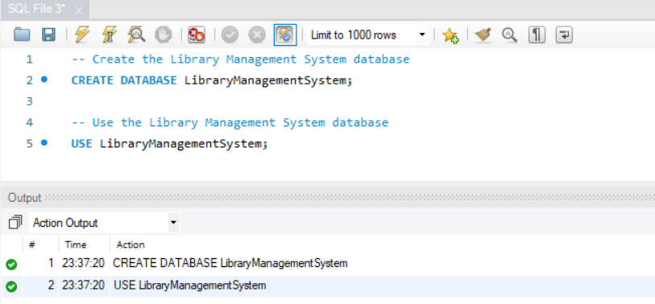
Creating a database named Library Management System.

Slide 3
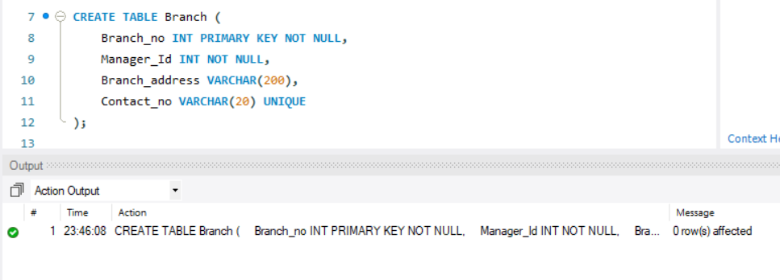
Creating table Branch and setting Branch_no as primary key

Slide 4
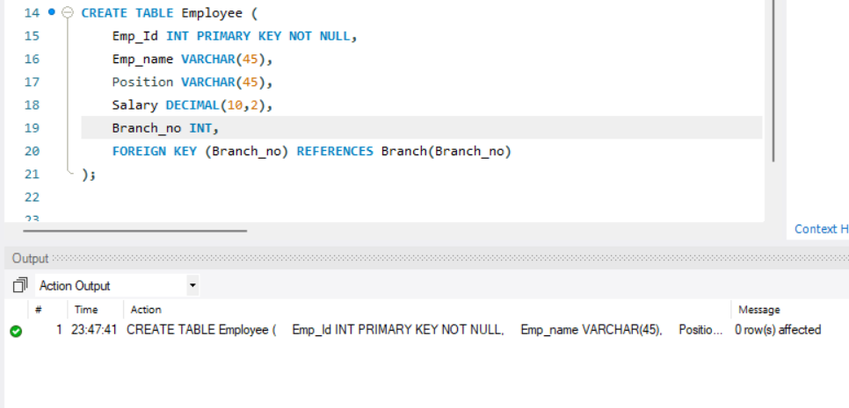
Creating TABLE Employee and setting Employee_id as primary key

Slide 5
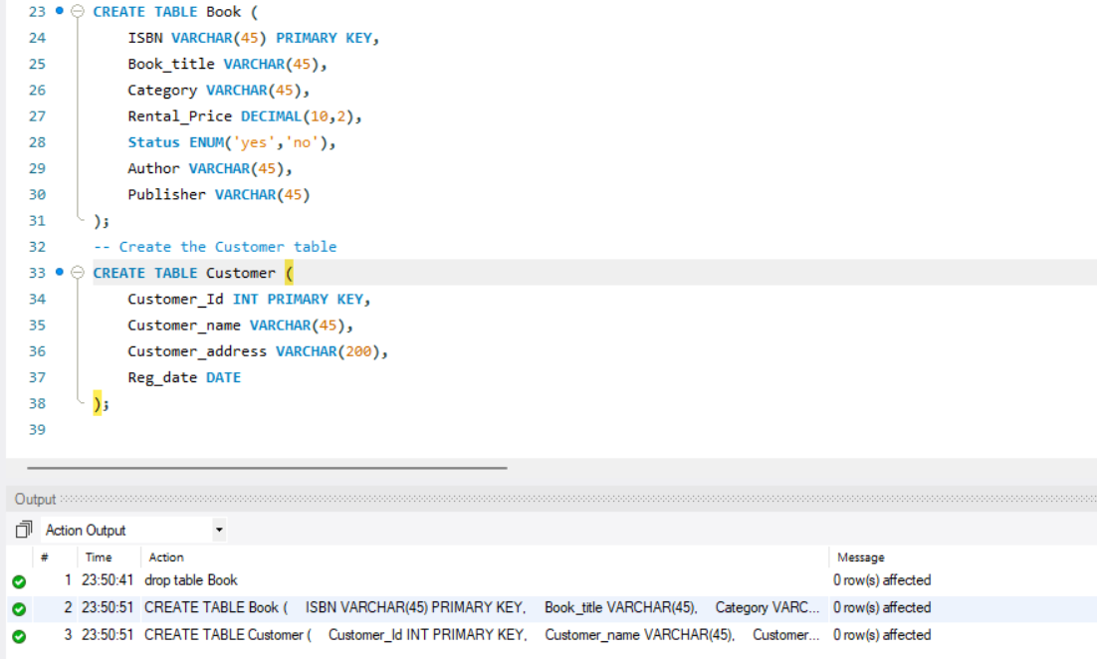
Creating the TABLES Book and Customer

Slide 6
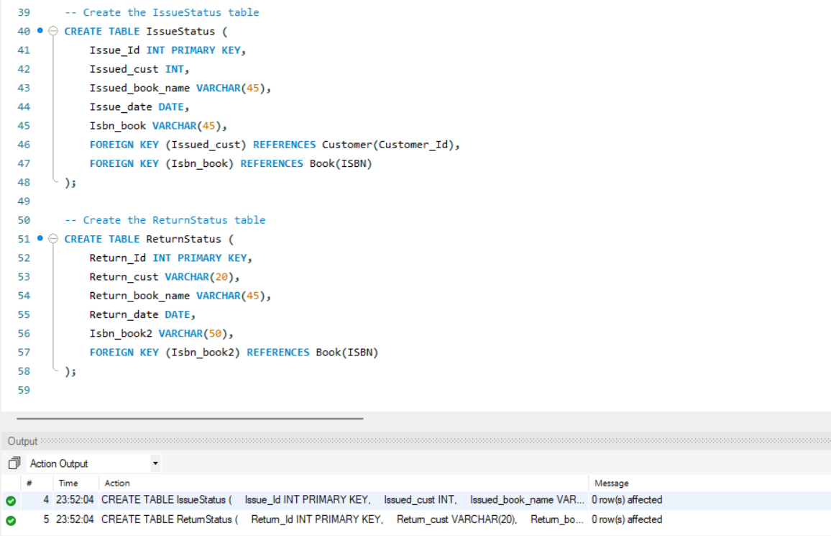
Creating the TABLES IssueStatus and ReturnStatus

Slide 7
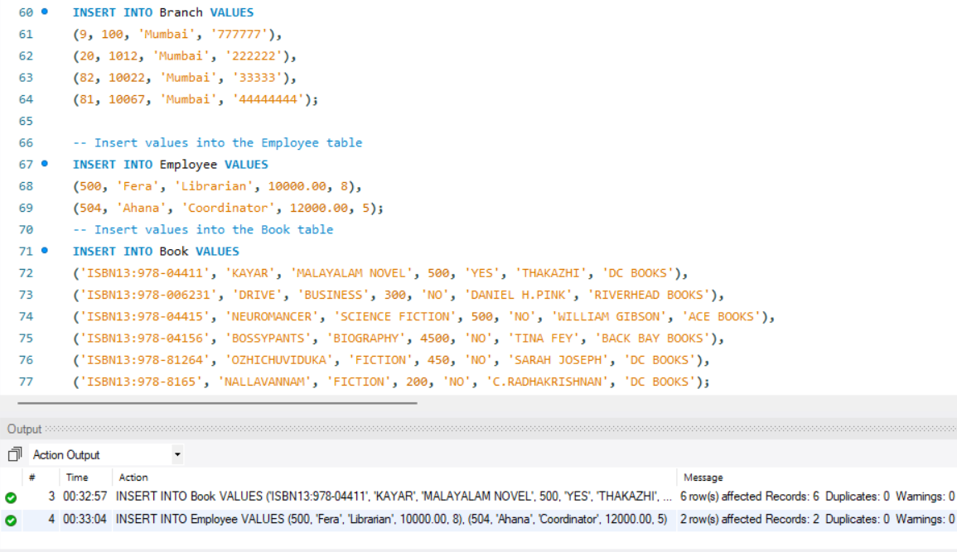
Inserting Values into respective TABLES

Slide 8
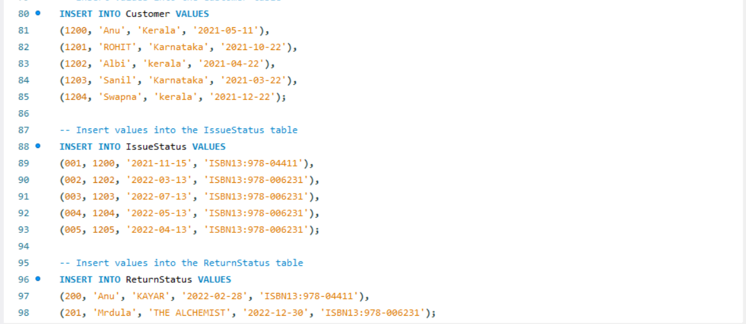
Inserting Values into respective TABLES

Slide 9
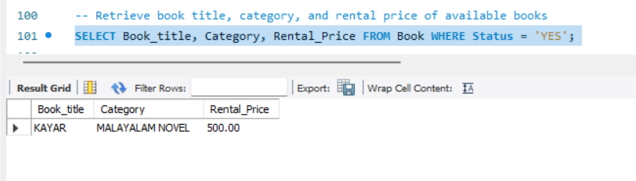
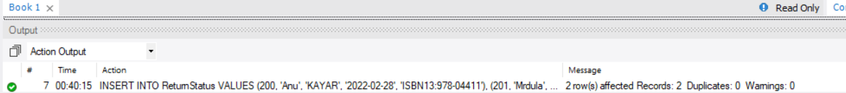
Retrieve book Title,Category and rental price of available books

Slide 10
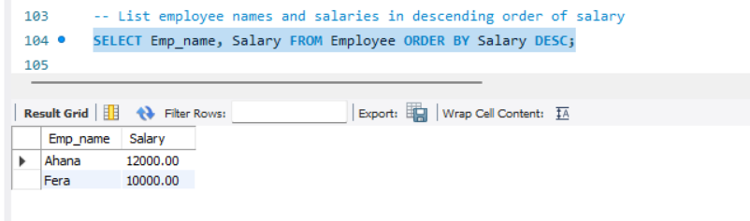
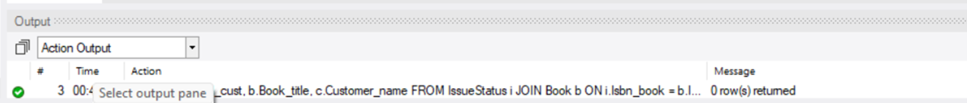
Listing Employee names and salaries in descending order of salary

Slide 11
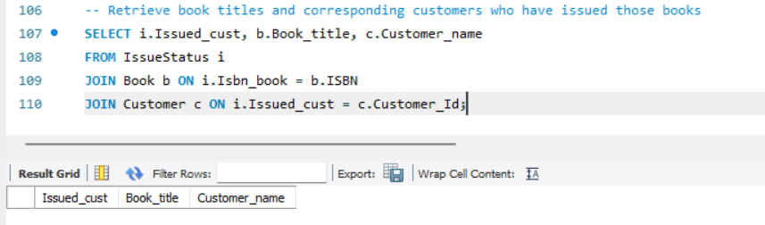
Retrieving book titles and corresponding customers who have issued those books

Slide 12
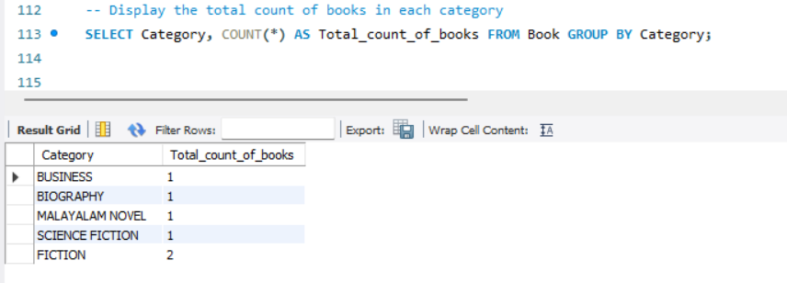
Displaying the total count of books in each category

Slide 13
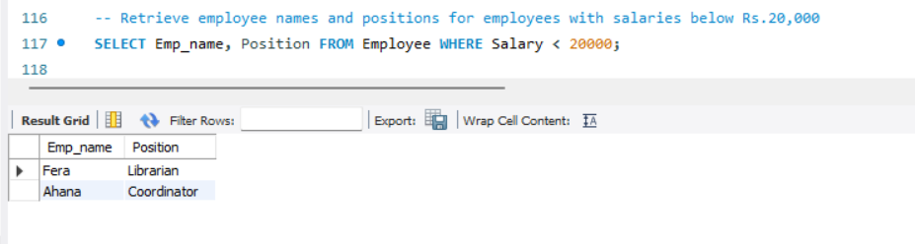
Retrieving employe name and positions for employees with salaries below Rs.20000

Slide 14
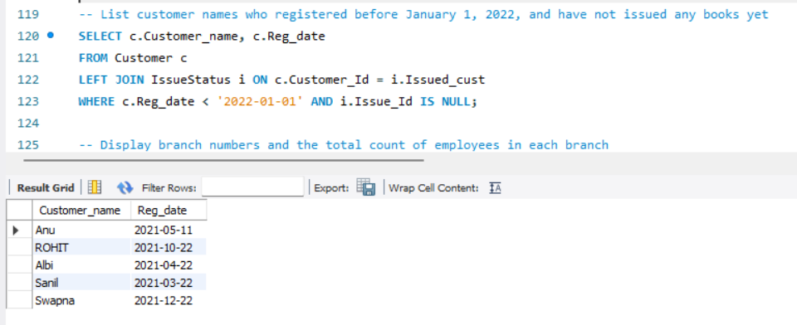
Listing customer names who registered before January 1,2022 and have not issued any books yet

Slide 15
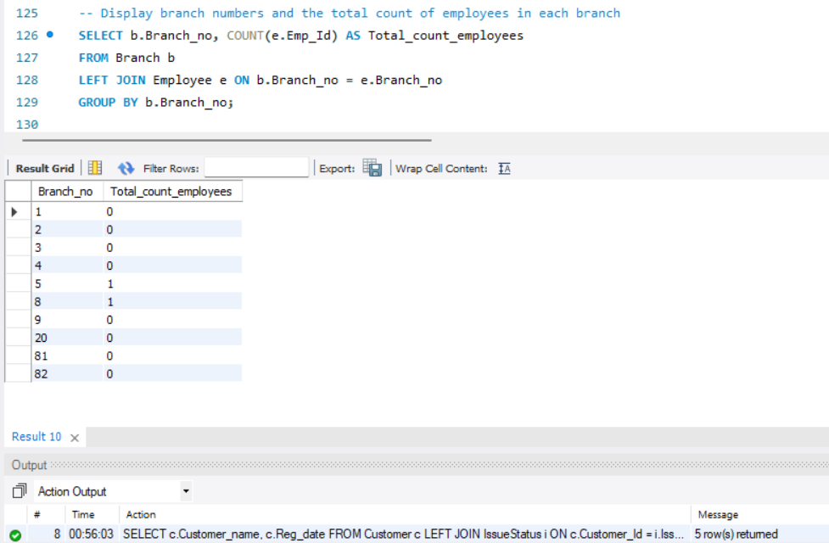
Displaying branch numbers and the total count of employees in each branch

Slide 16
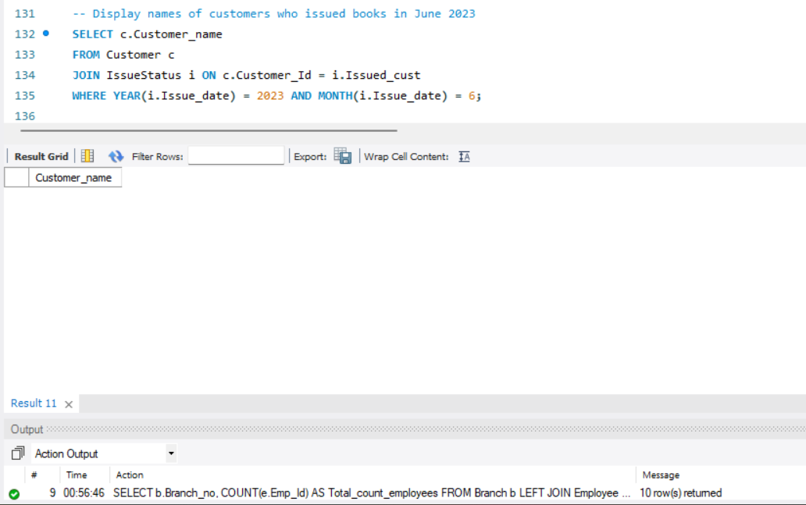
Displaying names of customers who issued book in June 2023

Slide 17
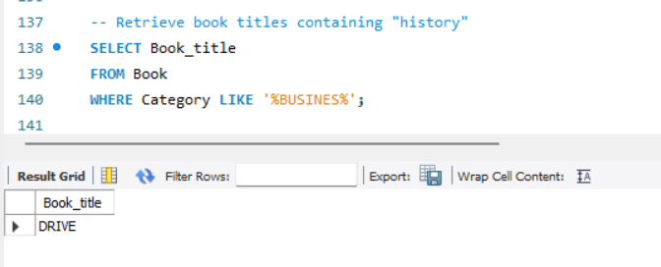
Retrieving book titles containing history

Slide 18
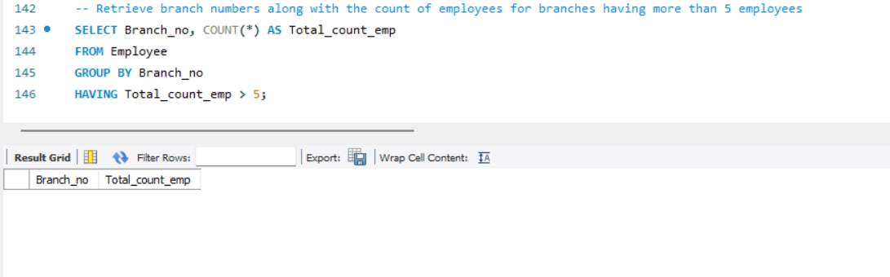
Retrieving branch numbers along with employees for branches having more than 5 employees

Slide 19
CONCLUSION
The Library Management System project provides an efficient way to analyze, organize, and manage library resources. By using MySQL queries, it effectively handles employee tracking, book status, customer records, and more. It facilitates extracting various information about the library environment, including book availability, customer preferences, and rental prices contributing to better library management.

